Slide 1
Geospatial Mapping with Coverage Overlays
Team 1610
Client: John Deere
Client Representatives: Benazir Fateh and Nicholas Sitter
Advisors: Swamy Ponpandi, Akhilesh Tyagi
Notes:
Brenda
Introduction of what the project is

Slide 2
Responsibilities
Team Leader: Luke Milius - Server deployment/Mapping interface
Database Leader: Brenda Lopez - PostGIS database/Mapping interface (county outlines)
Team Communication Leader: Jacob Caithamer - Reporting tool
Team Webmaster: Sarah Ulmer - Reporting tool
Team Key Concept Holder: Franklin Nelson - Mapping interface (markers)
Notes:
We should all talk briefly here about what we focused on
Luke - Server deployment, helped with mapping interface
Brenda - Implementation of PostGis database and county heat map
Jacob - Framework and front-end for the reporting tool, data generation and uploading
Sarah - Assisted in developing the reporting tool, specifically the bar graph functionality
Franklin - I worked on the interface of the map; implemented the markers, clustered markers, and heat map.

Slide 3
Table of Contents
Project Overview & Goal
Design Requirements
Design & Implementation
Future Goals
Q & A
Notes:
Brenda

Slide 4
Project Overview & Goal
Notes:
Brenda

Slide 5
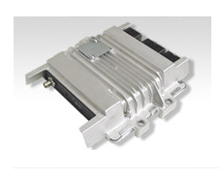
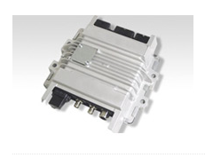
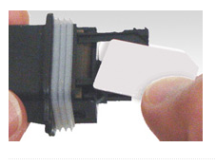
John Deere Telematics
The success of telematics solutions provided by John Deere depends on the satellite and wireless communication infrastructure. The telematics products are extensively drive tested. A drive test collects data from the GPS antenna attached to a commercial vehicle and formatted into a CSV file.
Satellite Gateway
Modular Gateway
SIM Plug
Notes:
Brenda

Slide 6
Why is our project important?
John Deere real-time products require great data coverage and AT&T coverage maps are not completely accurate
Business intelligence system for the client, so be able to market their products in areas with good coverage and determine areas that need coverage improvement.
This project will be integrated into existing applications and analyze existing data.
Notes:
Brenda
A lot of John Deere’s products are real time, and John Deere needs to know the areas with good coverage to know where their products will be successful. In their experience, the coverage maps AT&T provide are not entirely correct. With an accurate map, John Deere will be able to market their products and increase sales in areas with good coverage and can determine what areas need coverage improvement.

Slide 7
Conceptual Overview
Notes:
Brenda
Overview of how the project comes together

Slide 8
Goal
To design a lightweight interface for overlaying contextual information on geo-referenced maps and reports for intuitive coverage analysis.
Notes:
Brenda
The goal of our project is to design a lightweight mapping engine that makes coverage analysis intuitive and easy to visualize.

Slide 9
Market Survey
Current version used by John Deere
A few hundred to a thousand points that take over a minute to load each data point
Very limited possibilities for analyzing data
Lots of different mapping & analysis products
Notes:
Sarah
Many different mapping products exist, such as Mapbox, ArcGIS, or Google Maps. John Deere’s current mapping application uses Google maps but can only handle a limited number of data points, loads very slowly, and occasionally crashes. For all these reasons, John Deere created our project in order to have a mapping application that is efficient, lightweight, and able to handle larger amounts of data. While all of these mapping applications exist are capable of plotting data on a map, our project is unique because of the features and customization we provided for John Deere and the reporting tool, which provides further visualization of data through graphs

Slide 10
Design Requirements

Slide 11
Requirements
Functional
Transfer csv file data to database
Filter out map points by region
Change marker types & attributes they measure
Generate graph of drive test attributes
Non-functional
Render thousands of map points
Lightweight & Efficient
Secure
Notes:
Sarah
The functional requirements include being able to upload a CSV file of drive test data to the database, being able to filter map points, map different attributes in different ways, and generate graphs for the reporting tool. We met these requirements by creating an interface to upload and parse csv files of drive test data. With the mapping engine, different attributes of a drive test can be mapped with markers, clustered markers or a heat map, and can be filtered by drive test. The reporting tool generates line and bar graphs.
As it was mentioned before, John Deere’s current application is slow and unable to handle more than a couple hundred points, so the nonfunctional requirements of our project include being able to handle thousands of data markers while at the same time being lightweight and efficient. And lastly, the data from drive tests needed to be secure which we accomplished with spring security.

Slide 12
Risks
Time Constraint: Can’t plot points on map under one minute
Compromised Data: Data in server is not secure
Geolocation: Can’t find efficient method to calculate county boundaries
Notes:
Franklin
Time Constraint: There doesn’t exist a method of plotting out large number of points on map quick enough to be useful for our client to use.
Compromised Data: Sensitive data meant for our client gets leaked to public because of insufficient security.
Geolocation: There isn’t an efficient method of determining the boundaries of a state or county. Unless we can store info about the region during preprocessing, this will have to be done for every point placed on the map.

Slide 13
Resource/Cost Estimate
MapBox: $499 for 1 million map views per month
Amazon Web Server: Approx. $19 per month
Notes:
Franklin
MapBox is free to start out, with only 50,000 map views per month. Can step up to the premium package for 1 million map views for $499 per month. Only our client will use MapBox, so it is very unlikely that more than 50,000 map views will be needed. AWS server will be used in the later stages of project so we can use the same database when populating the map with points.

Slide 14
Project Milestones
October 5th - Finished first draft of project plan
October 22nd - Finished first draft of design document
November 6th - Finished second draft of project plan
November 17th - Demoed prototype to John Deere
December 8th - First semester demo
March 31st - Complete main development
April 4th - Second instructor meeting
April 25th - Final design & project plan
April 29th - Final Presentation
April 30th - Give handoff documentation to John Deere
Notes:
Franklin
Talk about how first half of semester was devoted towards planning and documentation, then the second half was implementing the prototype used in the demo on Nov 17

Slide 15
Design
Notes:
Luke

Slide 16
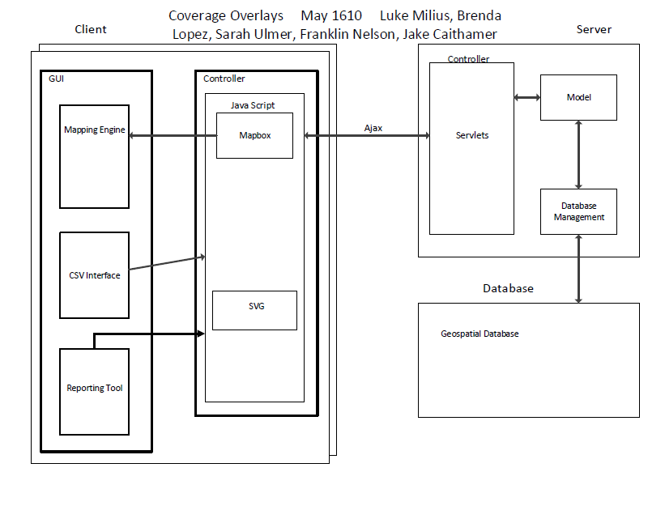
Schematic
Notes:
Luke
The client communicates to the server through HTTP requests. An Ajax request is used to submit and retrieve data from the server without having the reload the entire web page. Within the client, each module of the project will communicate through javascript back to the server, like the mapping engine, CSV upload interface, and the reporting tool.
The server handles all requests through the controller, which is implemented using a Model-View-Controller framework setup. The controller will communicate with the model to retrieve any information that is already stored in memory, otherwise the model will communicate with the database through our database management service layer.
The underlying database is hosted using a PostgreSQL database, with the PostGIS extension installed to handle and process geospatial data more efficiently.

Slide 17
Technologies Used
Java & Spring MVC
PostgreSQL with PostGIS
HTML5, Javascript, SVG
MapBox w/Heat & MarkerCluster
TIGER/Line® Shapefile
jQuery/AJAX
Notes:
Luke
The server backend is written in Java using the Spring MVC framework to handle all web requests. The database hosted on the server is PostgreSQL with the PostGIS extension installed to handle the geospatial data processing.
The client front end is displayed using HTML5 and Javascript, while we will be using SVG to display our graph data. jQuery API is used to make AJAX requests back to the server to either send or retrieve data without having to reload the entire web page.

Slide 18
Database Schema
dataPoints
dataid
time
fixtime
...
logfileid
geom
logFiles
logfileid
...
drivetestid
driveTests
drivetestid
name
notes
averages
averageid
drivetestid
...
Notes:
Luke
The database is set up in a hierarchical manner so that for each drive test, it is possible to have multiple log files tied to that drive test. The same goes for having multiple data points that are in each of the log files.
The logfileid and drivetestid fields are foreign keys to the respective tables to maintain the integrity of the data in the database.
The averages table supports part of the mapping interface to pre-compute averages for each county that exists in a drive test, in order to speed up the retrieval process of plotting and shading points and objects on the map.

Slide 19
Implementation
Notes:
Luke

Slide 20
Login
Login page backed by Spring Security
Challenges
Notes:
Luke
For the implementation, the login page has been developed using spring security in the back end to handle authentication and securing the web application. Spring Security is a module of Spring Framework that handles filtering of web requests and authentication of users.
During the implementation of this feature, it became a challenge to incorporate spring security into an existing spring application. At first, there were issues with how the web application was running and configured, so when the security was enabled, it would not allow any web pages to be loaded. Once I found and resolved the conflicts, I was able to get it functioning properly.

Slide 21
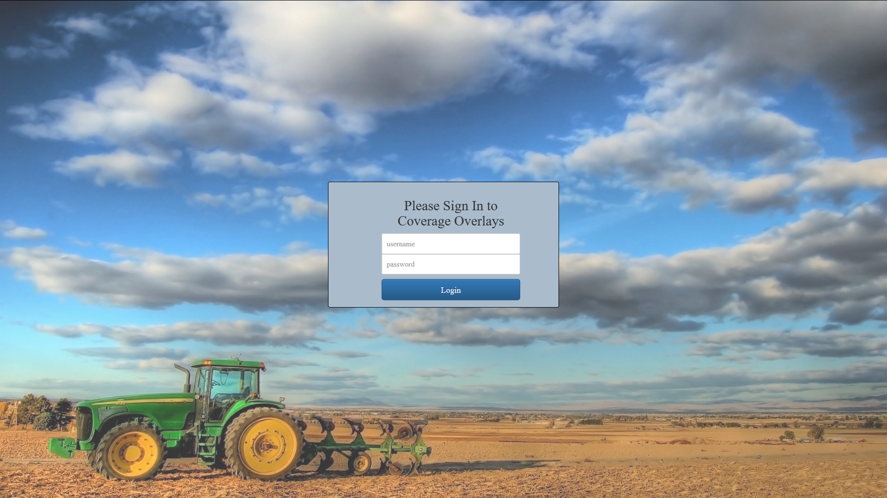
Notes:
Luke
Shown here is the login page, which will prompt the user for their username and password.

Slide 22
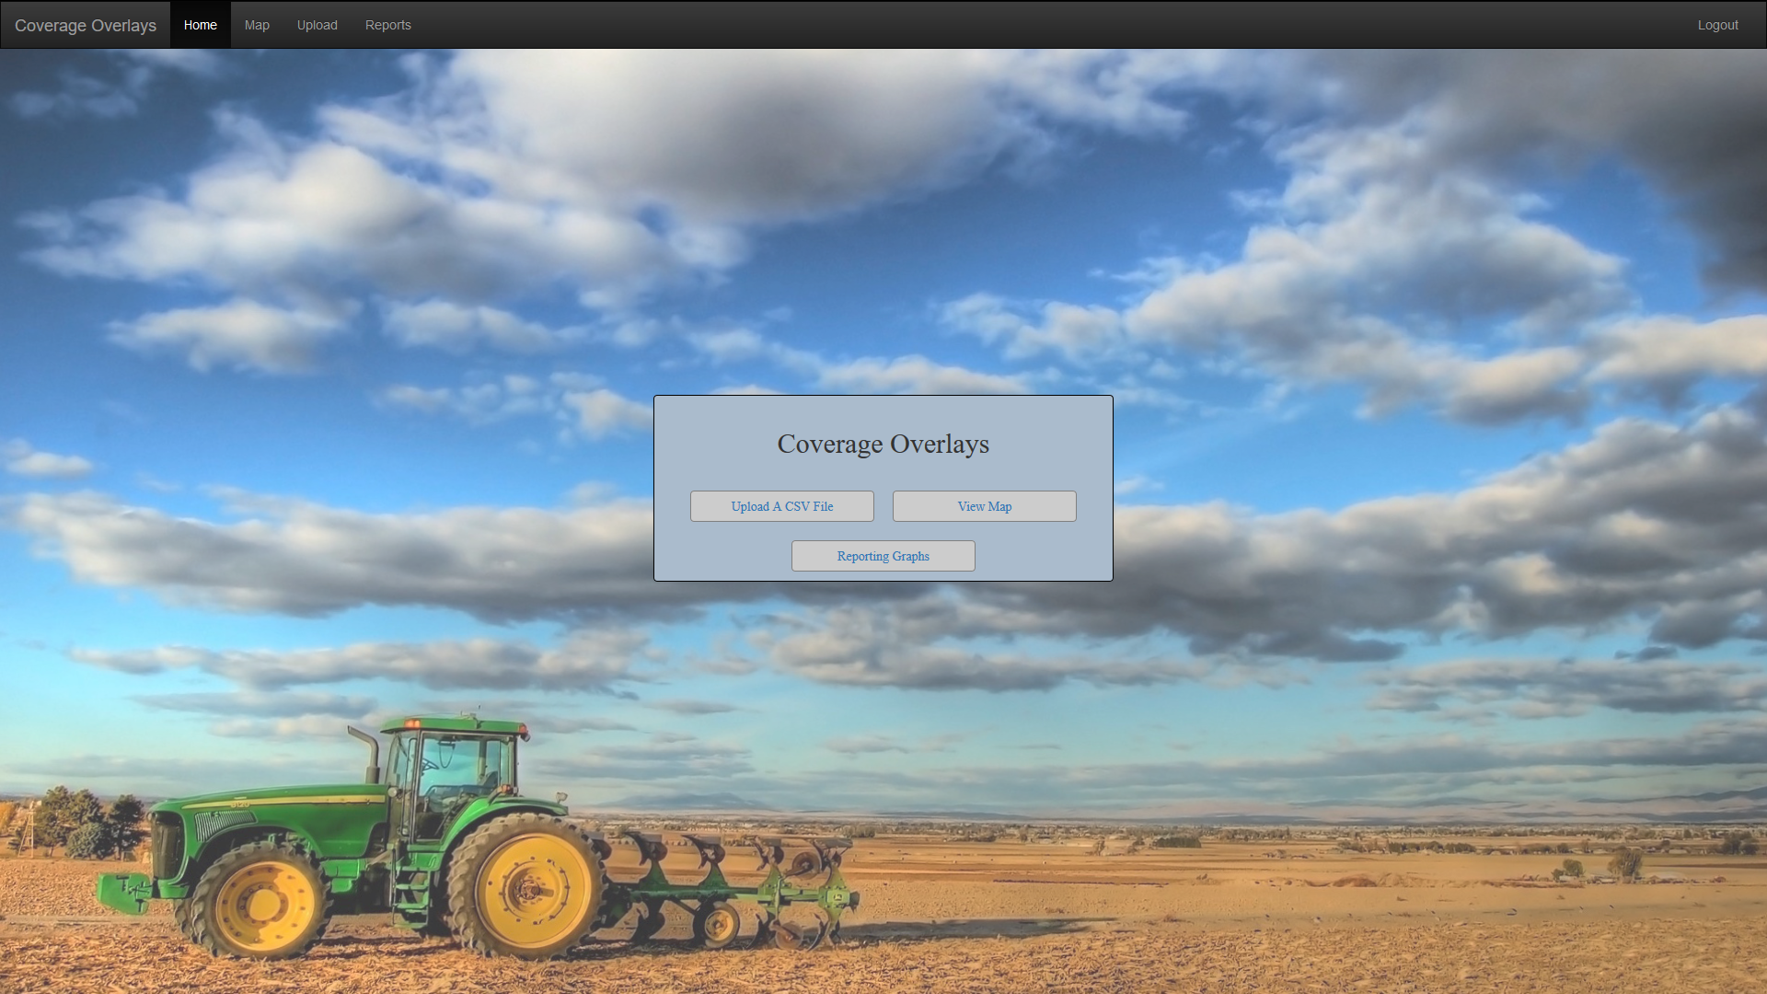
Notes:
Luke
Shown here is the login page, which will prompt the user for their username and password.

Slide 23
Upload
Create/Delete drive tests
Upload a csv file & put data in drive test
Create a random csv file
List data points contained in a drive test
Notes:
Jake could take this if no one else wants to

Slide 24
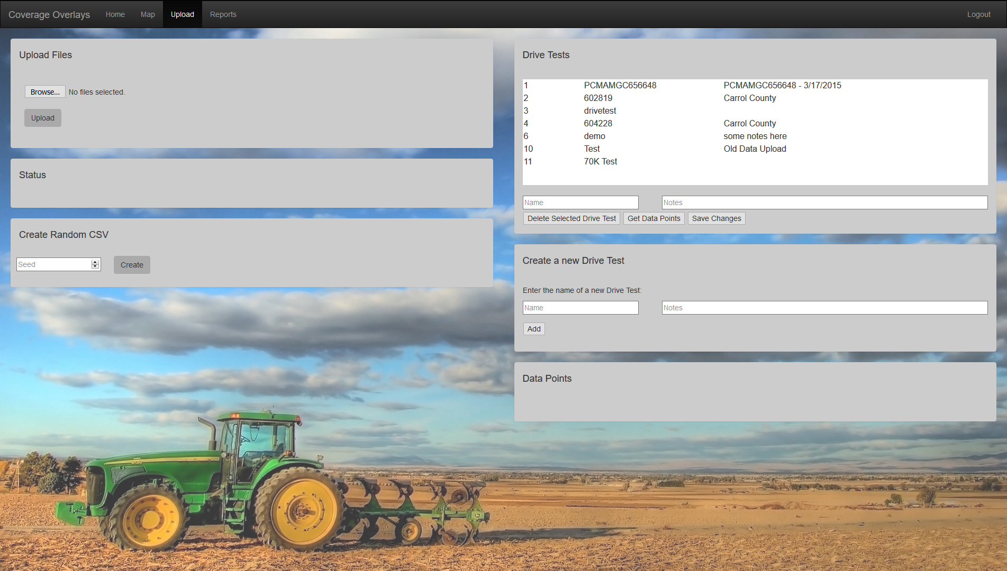
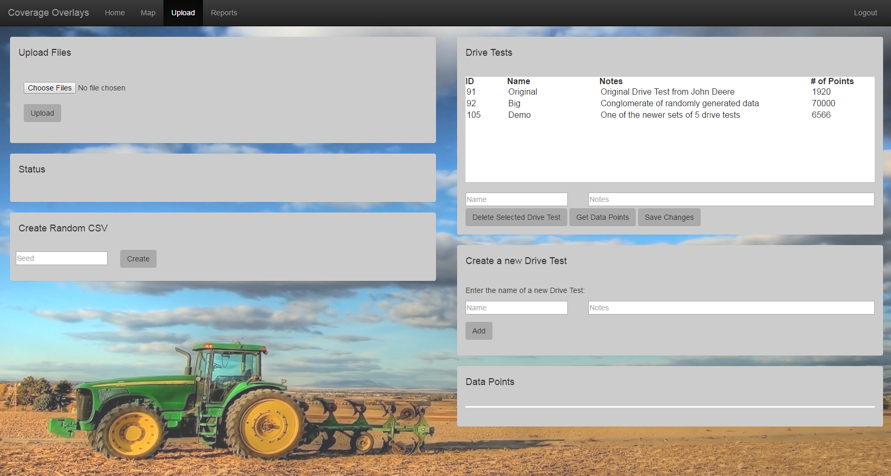
Notes:
Jake : I could take this, I guess? If we are gonna leave that data points table in here, though, it needs to be improved, cause it looks like crap right now. We should probably also include a way to edit existing drive tests or add notes to them. Ima just go add this stuff to Trello...

Slide 25
Map
Add/Remove markers to map from drive test
Change between:
Markers
Clustered Markers
Heat Map
Change attribute determining the colors of each marker
Change date range for markers
Notes:
Franklin

Slide 26
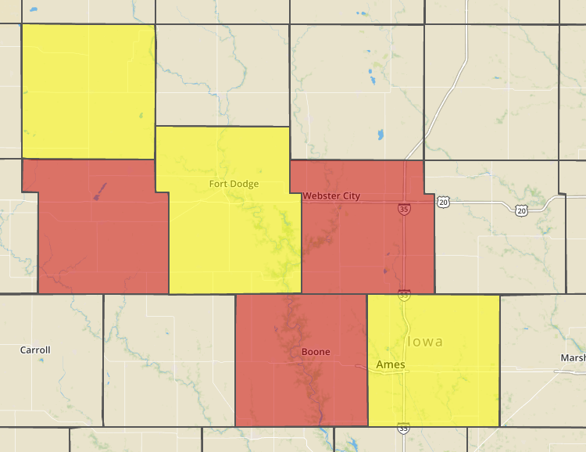
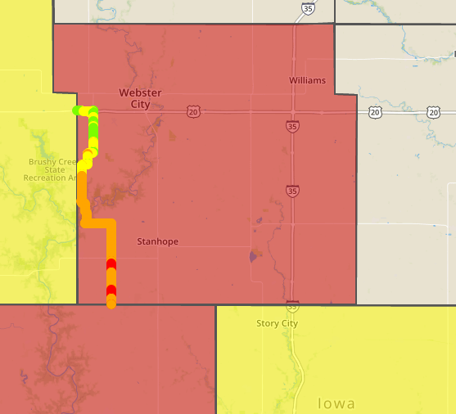
Map
Add/Remove county heat map (load time = 8.62 seconds with 70,472 data points)
Filter out markers based on county
Notes:
Brenda

Slide 27
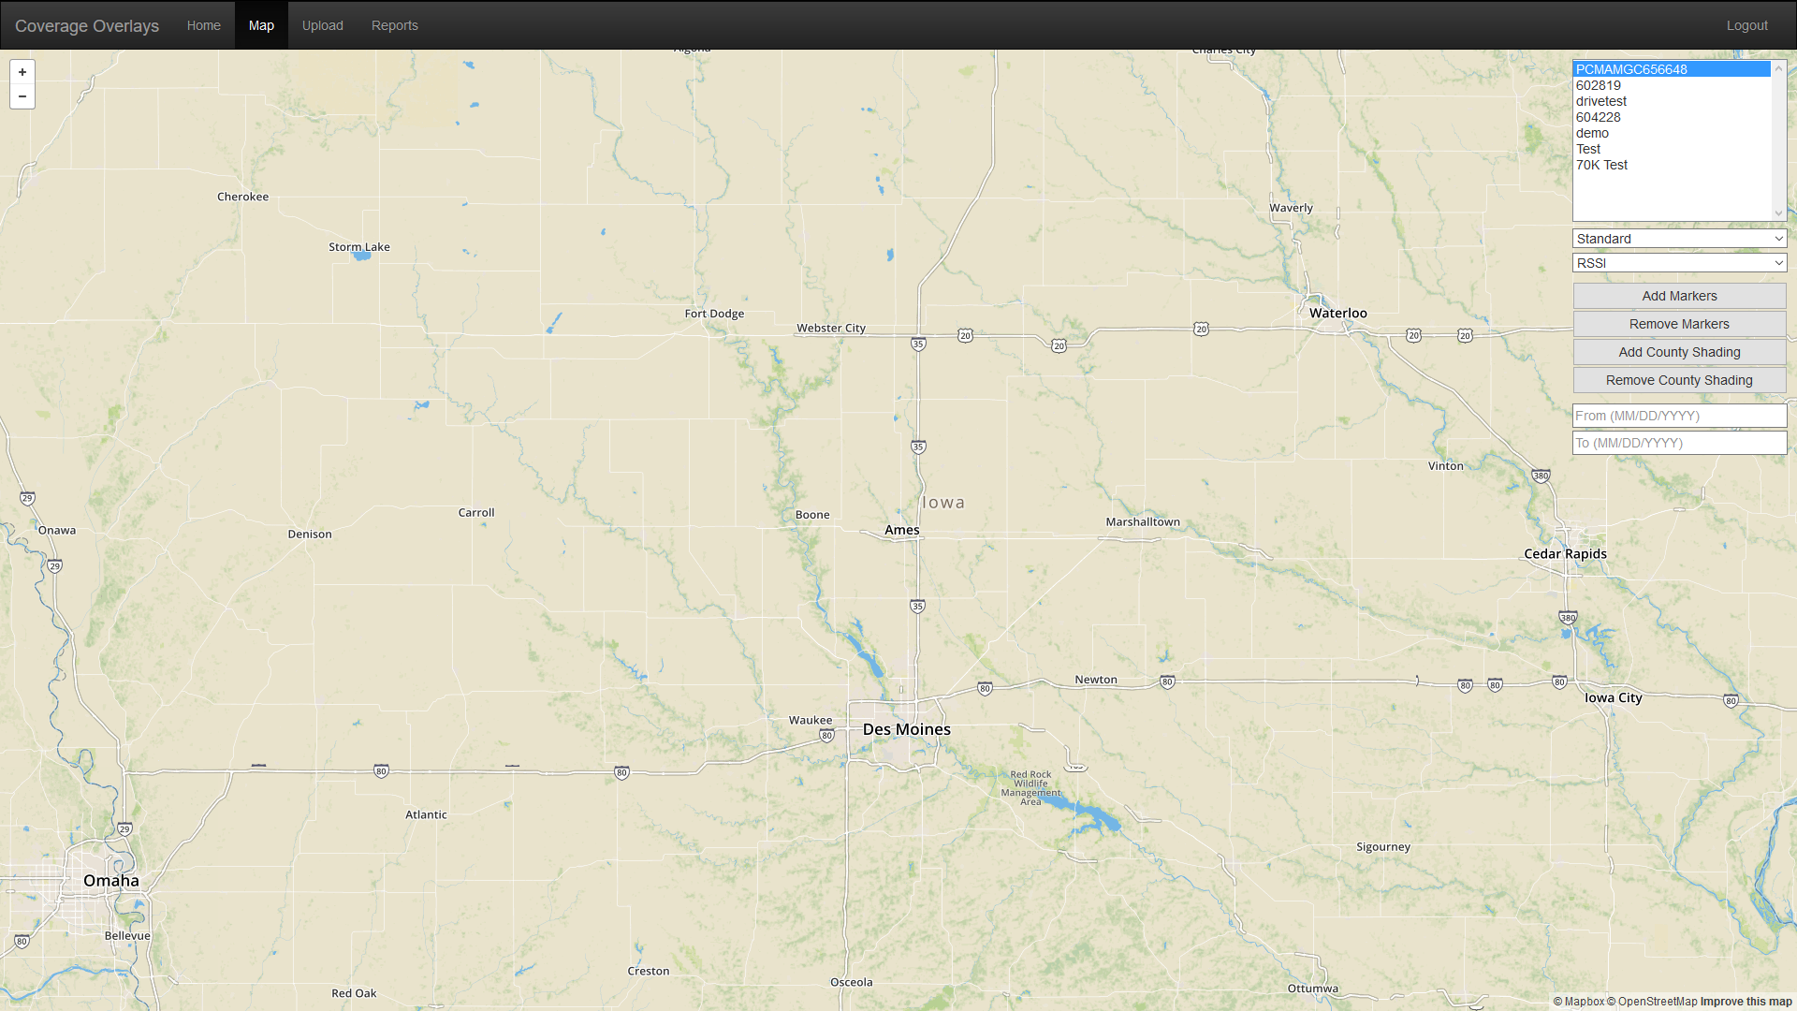
Notes:
Brenda

Slide 28
Exporting map to image
One of the harder challenges in this project because leaflet-image does not work well with custom markers & plugins
Notes:
Franklin - The plugin was made for vanilla mapbox, third party additions to it were not supported (and therefore would not be represented in the exported image)

Slide 29
Reporting Tool
SVG-based graphs & charts
Used to search for relations between different metrics
View an area or metric over time
Save screenshots of interesting data
Notes:
Jake
SVG because it is widely compatible across different platforms, scales very well (both in terms of zooming in/out and in terms of data size)
Can talk some crap about different potential uses
Could mention our framework and how to add new visualizations
Demo or video of the screenshot functionality

Slide 30
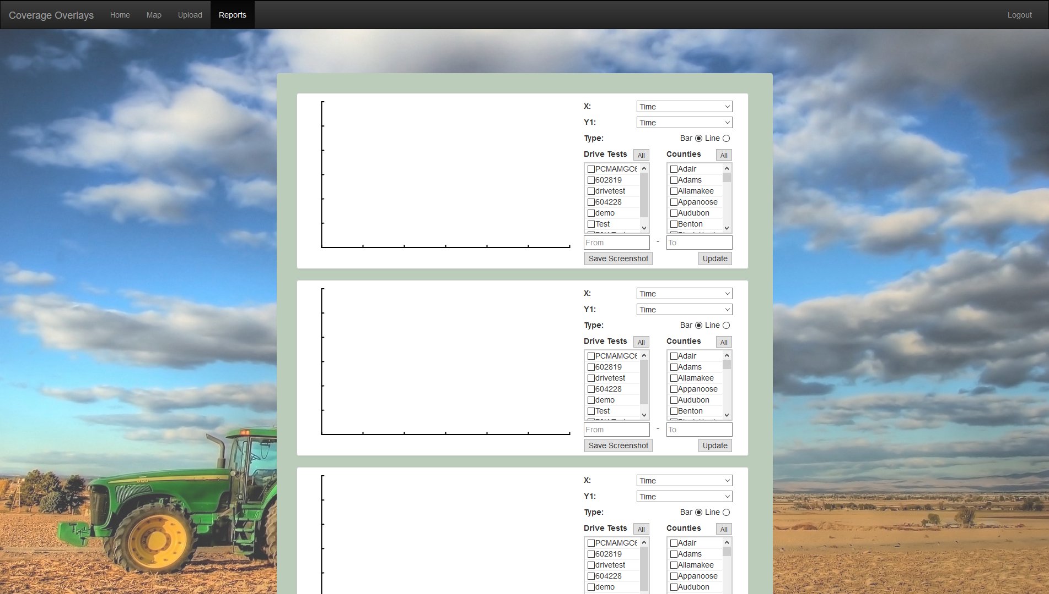
Notes:
Jake
Video of using the graphs and saving a screenshot, i guess

Slide 31
Moving Forward
Final Documentation
Handoff & Integration
Completed!
Notes:
Jake
Talk about some improvements we can make to the UI (combine map & reporting tools, polish graphs, removing testing features, etc)
Walk through our testing plan or lack thereof
Talk about what we’ll be giving to John Deere (eg, source code, documentation, hand-off document, design document, how-tos)

Slide 32
Conclusion
Project goal
Design & Project Plan
Technical Choices
Progress
Future Plans
Notes:
Jake - Review the presentation and briefly discuss each section
Jake

Slide 33
Questions?
Notes:
Take Questions

Slide 34
Why is the project lightweight?
For 70,472 data points:
Cluster markers load time is 42.87 seconds.
Heatmap markers load time is 3.0 seconds.
Uploading the data points into database takes 6-12 seconds.
Mapbox Interface:
Mapbox uses vector tiles, which are image tiles for web maps. The vector tiles contain vector data for each part of a layer. Allowing to cache, and scale the map rapidly.

Slide 35
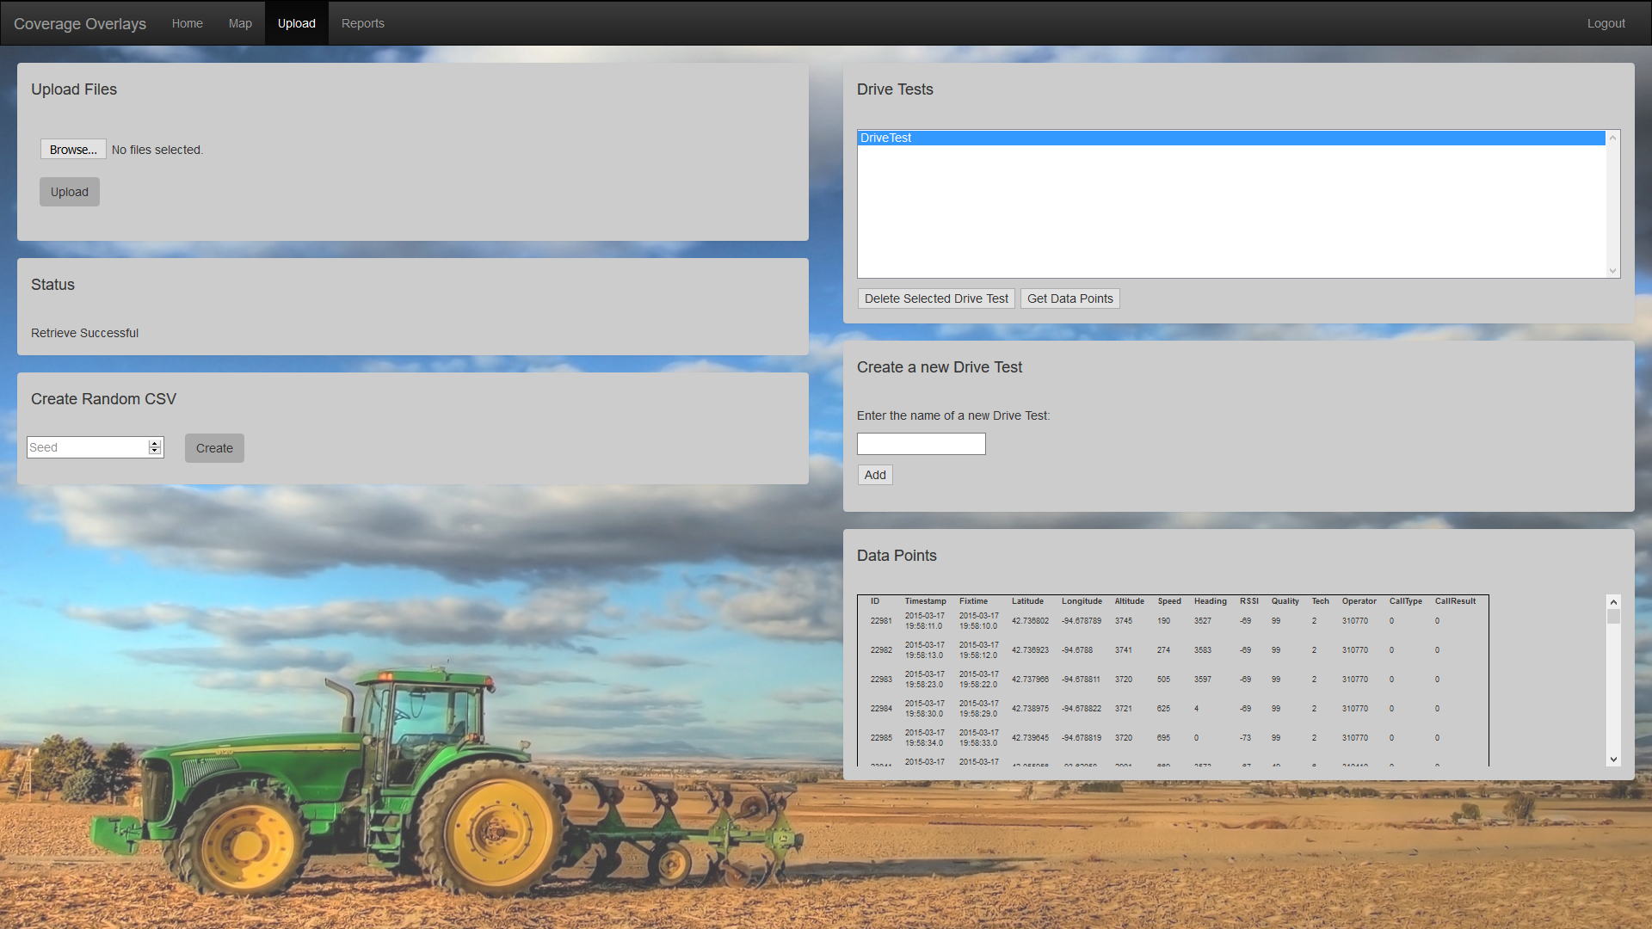
Notes:
Jake : I could take this, I guess? If we are gonna leave that data points table in here, though, it needs to be improved. We should probably also include a way to edit existing drive tests or add notes to them. Ima just go add this stuff to Trello…
Probably should remove this, too

Slide 36
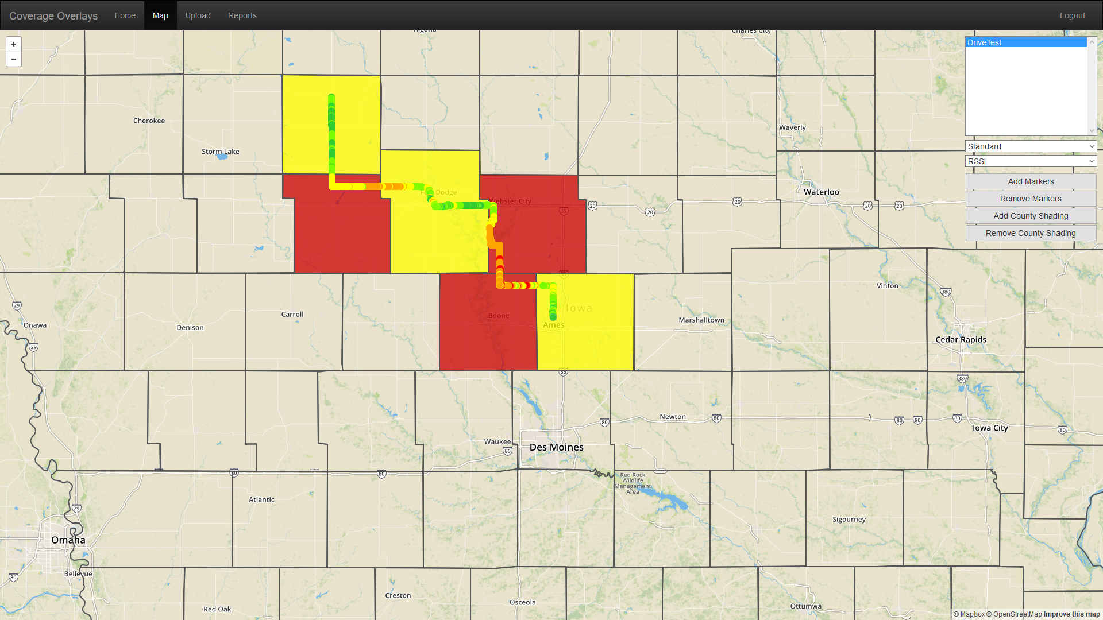
Notes:
Franklin

